Slide 1

3. UV-Vis spectra for organic compounds
1) Saturated compounds
Alkanes：only σ→σ* transition，λ = 150 – 160 nm, far ultraviolet region/vacuum ultraviolet region.
Saturated compounds with lone pair electrons：σ→σ* and n→σ* transitions, mainly in far ultraviolet region, only partly weak absorption around 200 nm.
Notes:
中: Chapter 3.2.1 真空紫外吸收带

Slide 2
2) non-conjugated unsaturated compounds
Non-conjugated alkenes and alkynes：
Single π→π* transition，still in far ultraviolet region.
eg. ethene 165nm，ethyne 173nm；
Unsaturated compounds with lone pair electrons：
Ketones, carboxyl derivatives and nitro-compounds, etc.
Single σ→σ*、n →σ*、π→π*、n →π* transitions.
Only n →π* in the near ultraviolet region (270 – 300 nm)
Weak absorption (ε ~ 100), so-called R band
Notes:
中: Chapter 3.2.1 R带

Slide 3
3) Conjugated aliphatic compounds
Conjugated π→π* transition, so-called K band
K band: high absorption intensity (ε_{max} ≥10⁴)
λ_{max} is related with conjugation length, + 1 double bond ~ + 30 nm
There is n→π*, but covered by π→π* band since its weak intensity
Notes:
中: Chapter 3.2.1 K带

Slide 4
How to predict λ_{max} ?
Conjugated alkenes: Woodward rule and Fieser-Kuhn rule
α,β－unsaturated carbonyl compounds: Woodward rule
Three steps:
Parent structure
Substitution contributions
Then…
3. Make sure you don’t make mistakes during calculation…
Notes:
英: 1.11-1.13
中: 3.3.1

Slide 5
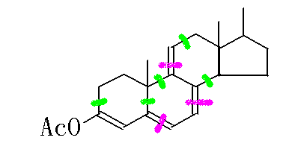
1）Woodward rule & Fieser-Kuhn rule (K band for conjugated alkenes)
Parent s-cis diene 253nm
2 double-bond extension 2×30
5 alkyl substitution 5×5（green）
3 exocyclic double bond 3×5（purple）
1 RCO₂- substitution 0
λmax (cal.) 353nm（exp. 353nm）

Slide 6
Exocyclic double bond环外双键：即在环外、与环直接相连的 C=C双键,即C=C双键中的一个碳原子在该环上，另一个碳原子不在该环上的情况。该环外双键要在共轭体系中才产生贡献.

Slide 7
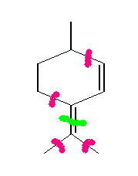
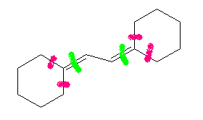
217（parent）
+ 5（1 exocyclic double bond）
+ 4 × 5（4 alkyl substitution）
= 242
217（parent）
+ 2 × 5（ 2 exocyclic double bond ）
+ 4 × 5（ 4 alkyl substitution ）
= 247
Notes:
P78 2-3 (1)、（2）

Slide 8
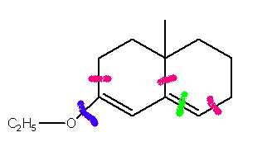
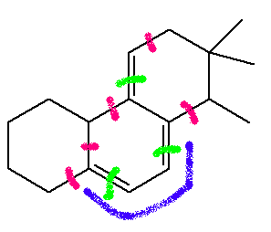
214（parent）
+ 5（1 exocyclic double bond）
+ 3 × 5（3 alkyl substitution）
+ 6 （1 OR substitution）
= 240
253（parent）
+ 30 （1 double bond extension）
+ 3 × 5 （ 3 exocyclic double bond ）
+ 5 × 5（ 5 alkyl substitution ）
= 323
Notes:
P78 2-3 (3)、 （4）

Slide 9
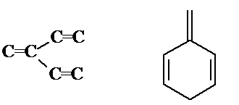
Exceptions A. Cross-conjugated systems
B. Stereo-hindrance/distortion
cal：229 nm
exp：245.5 nm

Slide 10
α,β－unsaturated carbonyl parent structures

Slide 11
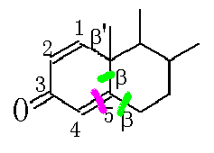
2) Woodward rule
Parent O=C-C=C 215nm
2 β-Alkyl substitution 2×12 （green）
1 exocyclic double bond 5 （purple）
cal. λmax 244nm
exp. λmax 245nm （ethanol）
note: choose parent structure with more substitutions
Notes:
英: 1.14-1.16
中: 3.3.2

Slide 12
If there are more than one α，β-unsaturated carbonyl parent structures，choose the most conjugated structure as parent
Parent Conjugated double bond extension Exocyclic double bond Homodiene Alkyl substitution β- γ- or farther Cal. Exp. | 215 nm 30×2 5 39 12 18×3 385 nm 388 nm

Slide 13
If there are more than one cyclic carbonyl groups, choose one as parent, and others are not calculated as exocyclic double bond but alkyl substitution
Parent Exocyclic double bond Alkyl substitution α- β- Cal. Exp. | 215 nm 5×2 10 12×2 259 nm 254 nm

Slide 14
Now it’s Your turn~
Notes:
319
381

